Slide 1





Housing Project: Transforming, Configuring & Learning
By Juan Villegas
4/12/23

Slide 2

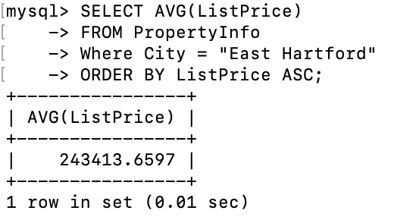
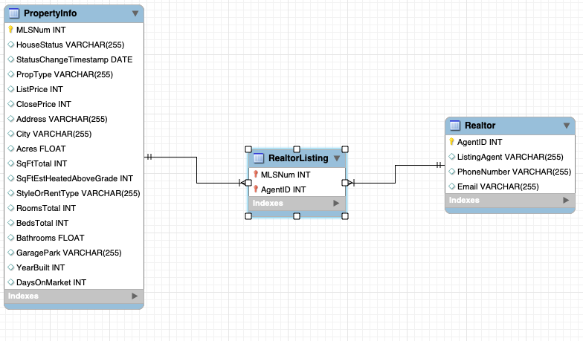
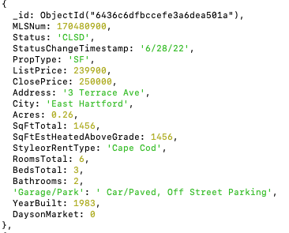
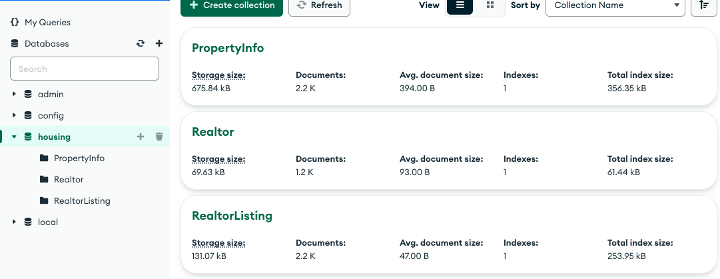
Background
MongoDB: NoSQL document database that allows for flexible and scalable data storage. Stores data as JSON-like documents with dynamic schemas, this allows for storing unstructured or semi-structured data.
MongoDB (GUI) Compass provides an interface for exploring data, creating/managing collections/documents, and running queries/aggregations.
MySQL: An open-source relational database management system that uses SQL (Structured Query Language) to store and manipulate structured data.
MySQL (GUI) WorkBench: An interface to do tasks such as designing and creating databases, tables and relationships, and running queries and reports.
Schema: A blueprint that describes the structure and organization of a database. It defines the tables/collections, fields/columns, and the relationships between tables.

Slide 3
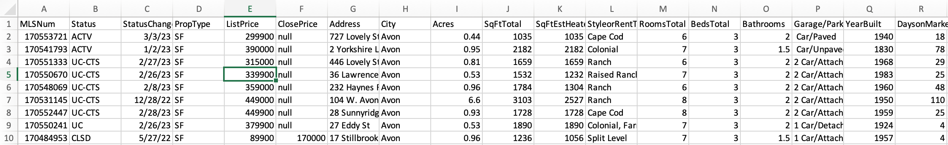
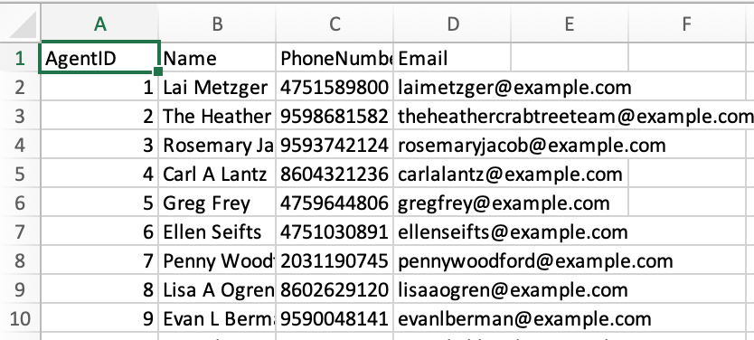
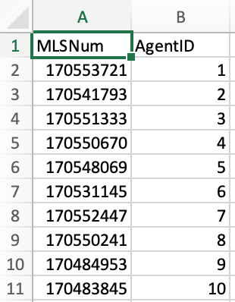
Dataset Transformation
Fig 1: OG Dataset from Realtor
Fig 2: PropertyInfo Dataset: Cleaned up
Fig 3: Realtor Dataset: Fake Data (Email +Phone #)
Fig 4: RealtorListing Dataset (Intersection Table)

Slide 4
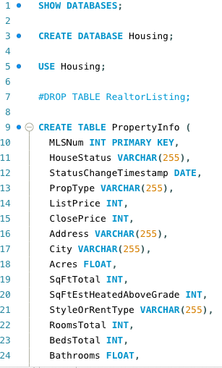
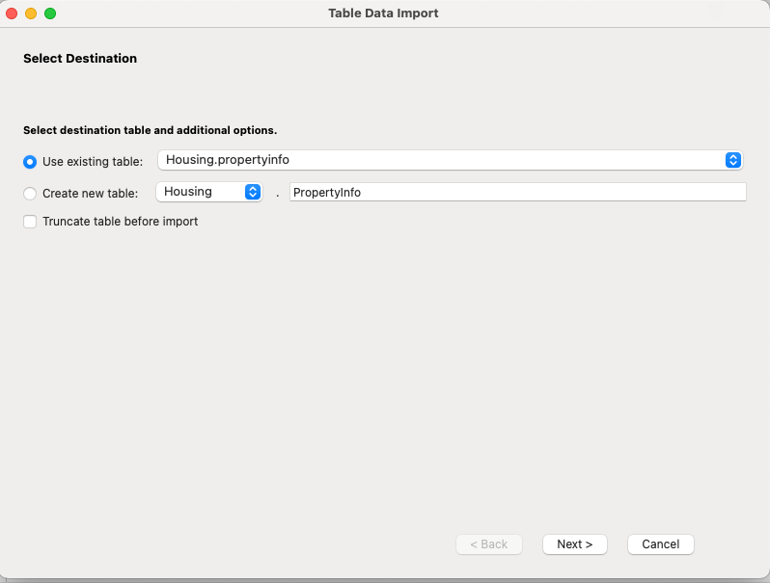
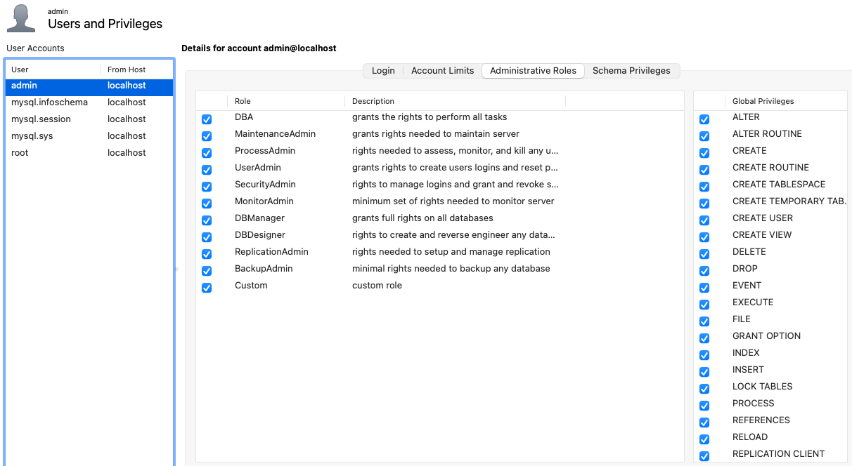
Database Creation & Configuration (MySQL)
Fig 1: Query to create DB + Tables
Fig 2: Using MySQL WorkBench to Import data
Fig 3: Creating Users & Granting Permissions

Slide 5
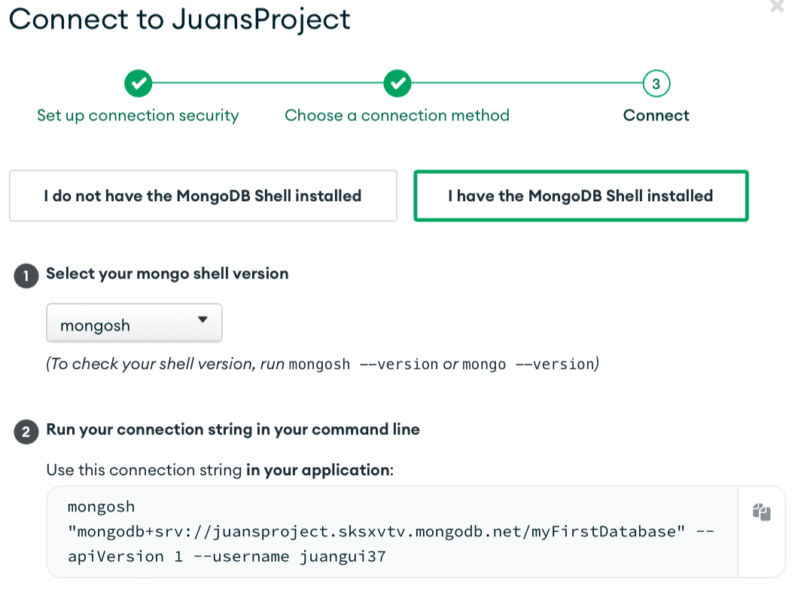
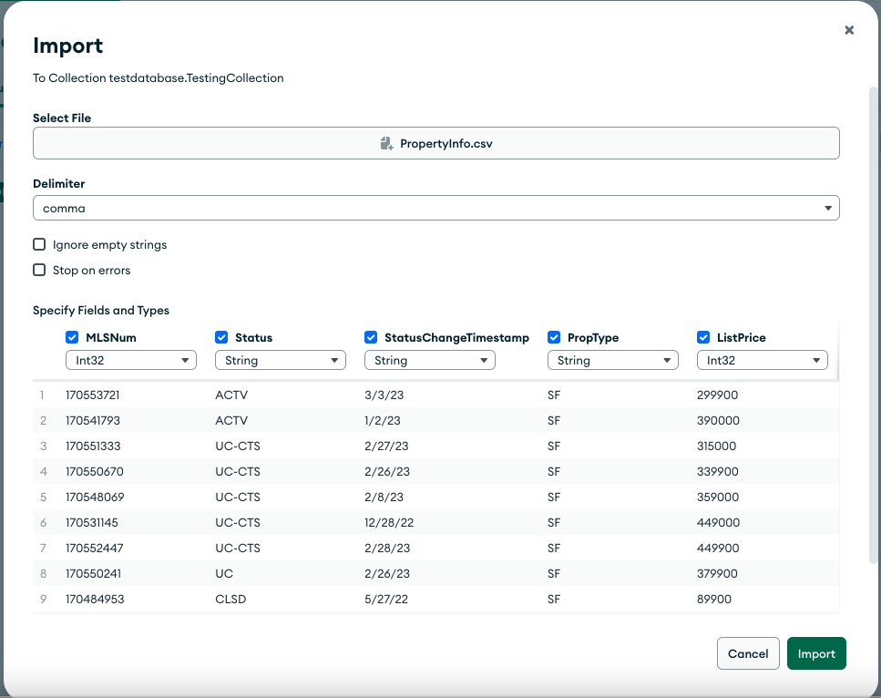
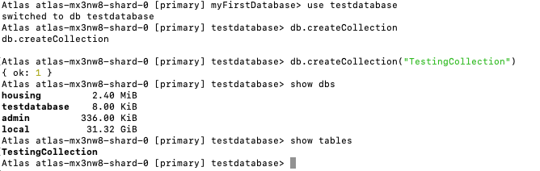
Database Creation & Configuration (MongoDB)
Fig 2: Creating Database + Collection
Fig 3: Importing data to Database on MongoDB Compass
Fig1: Grabbing ‘Connection String’ from MongoDB.com

Slide 6
Demonstration of Learning

Slide 7
Next Steps: Performance Testing + EDA
Learn how to use JMeter
1
Compare the Performance testing:
Query speeds
Insertion speed
Update speed
Scalability
Load Testing
Conduct an EDA on the Realtors data:
2
Use a connector on python to extract this data from the databases

Slide 8
Questions
Do you have any criticism regarding how I’m going to test the performance of my databases?
How many weeks do we have left:
How much time should I spend doing the EDA/Performance Testing? I still must create a classification & predictive model.
Given that everyone tells me I should be comfortable with SQL, should I continue playing with SQL queries?

